Slide 1
Introduction to Golang

Slide 2

Go is an open source programming language that makes it easy to build simple, reliable, and efficient software.

Slide 3
Why should we learn a new Language?
Go is expressive, concise, clean, and efficient – says a lot !!
Go is easy and fun ☺
Just play along and you’ll find out

Slide 4
Go at Google
Go is a programming language designed by Google to help solve Google's problems, and Google has big problems
The hardware is big and the software is big.
  many millions of lines of software, with servers mostly in C++ and lots of Java and Python for the other pieces.
  Thousands of engineers work on the code, at the "head" of a single tree comprising all the software,
  From day to day there are significant changes to all levels of the tree.
  A large custom-designed distributed build system makes development at this scale feasible, but it's still big.

Slide 5

Go at Google
And of course, all this software runs on zillions of machines, which are treated as a modest number of independent, networked compute clusters.

Slide 6
Pain points
Slow builds
Uncontrolled dependencies
Each programmer using a different subset of the language
Poor program understanding (code hard to read, poorly documented, and so on)
Duplication of effort
Cost of updates
Difficulty of writing automatic tools
….

Slide 7
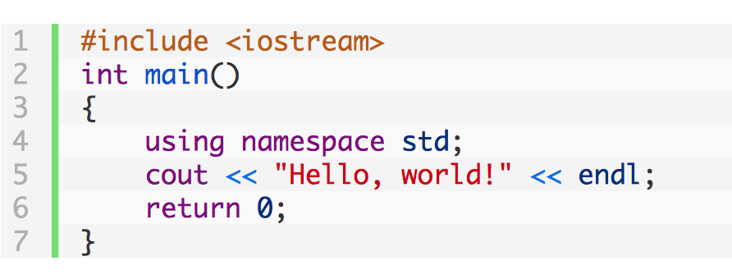
Header files in C++
Notes:
http://www.learncpp.com/cpp-tutorial/19-header-files/

Slide 8
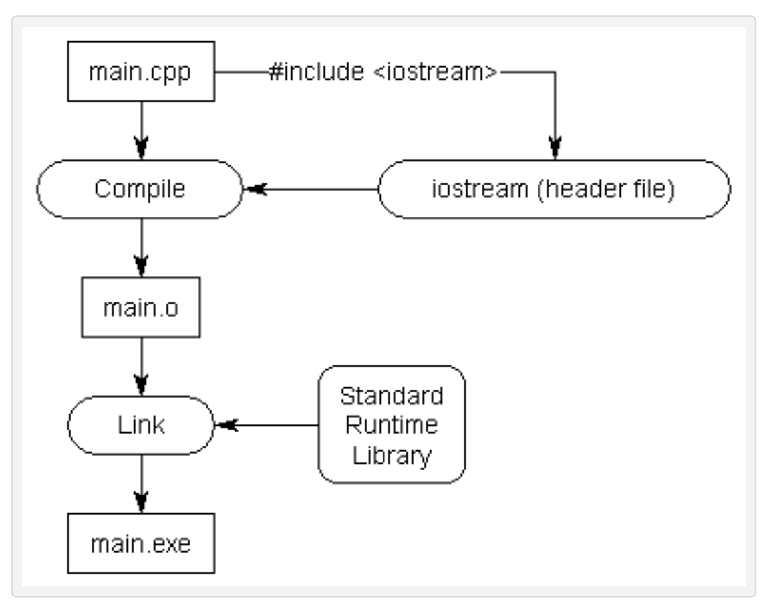
Header files in C++

Slide 9
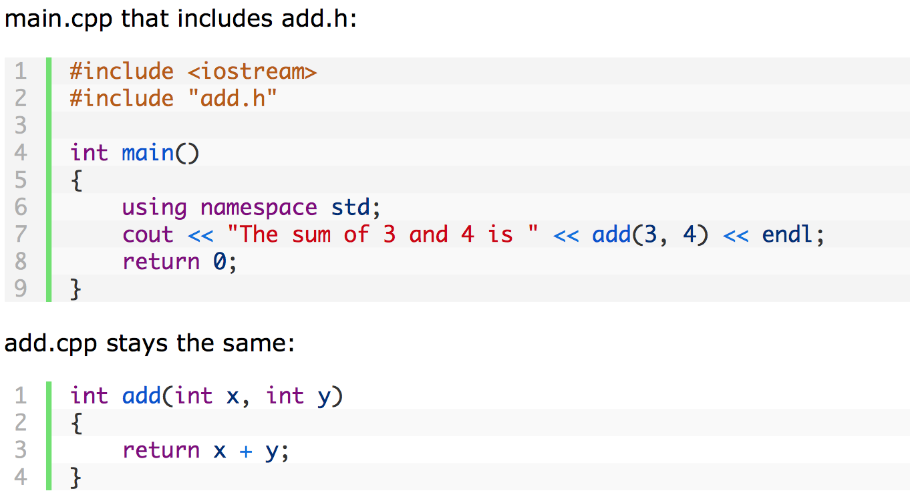
Header files in C++

Slide 10
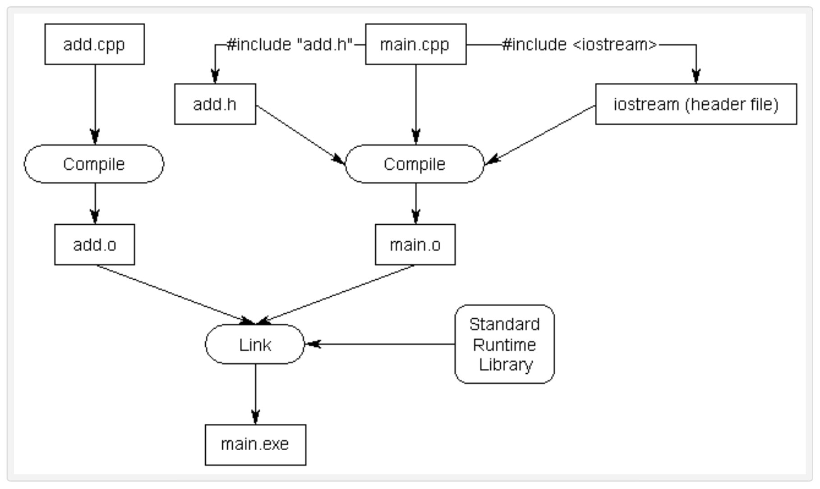
Header files in C++

Slide 11
Header files in C++
Header files consist of two parts.
  The first part is called a header guard
  The second part is the actual content of the .h file

Slide 12
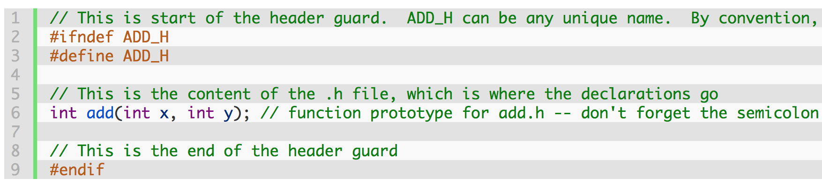
Header files in C++
Notes:
http://www.learncpp.com/cpp-tutorial/19-header-files/

Slide 13
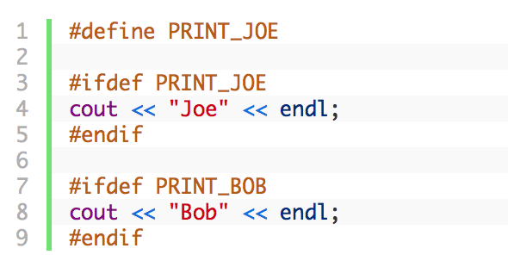
Dependencies in C and C++
The #ifdef preprocessor directive allow the preprocessor to check whether a value has been previously #defined. If so, the code between the #ifdef and corresponding #endif is compiled. If not, the code is ignored.

Slide 14
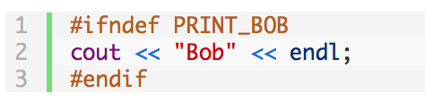
Dependencies in C and C++
#ifndef is the opposite of #ifdef, in that it allows you to check whether a name has NOT been defined yet.

Slide 15
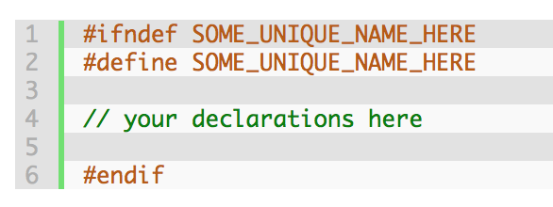
Dependencies in C and C++
Header guard, prevent a given header file from being #included more than once from the same file.

Slide 16
Nice… but it scales very badly
In 1984, a compilation of ps.c, the source to the Unix ps command, was observed to #include <sys/stat.h> 37 times by the time all the preprocessing had been done.
The construction of a single C++ binary at Google can open and read hundreds of individual header files tens of thousands of times.
Notes:
The ps command reports information on current running processes, outputting to standard output.

Slide 17
Dependencies in C and C++
In 2007, build engineers at Google instrumented the compilation of a major Google binary.
  Two thousand files that, when concatenated together, totaled 4.2 megabytes.
  By the time the #includes had been expanded, over 8 gigabytes were being delivered to the input of the compiler, a blow-up of 2000 bytes for every C++ source byte.

Slide 18
Dependencies in C and C++
That 2007 binary took 45 minutes using a distributed build system
When builds are slow, there is time to think. The origin myth for Go states that it was during one of those 45 minute builds that Go was conceived.

Slide 19
Dependencies in Go
import "encoding/json"
The first step to making Go scale, dependency-wise, is that the language defines that unused dependencies are a compile-time error (not a warning, an error).

Slide 20
Dependencies in Go
package A imports package B;
package B imports package C;
package A does not import package C
This means that package A uses C only transitively through its use of B; that is, no identifiers from C are mentioned in the source code to A, even if some of the items A is using from B do mention C

Slide 21
Dependencies in Go
To build this program,
  first, C is compiled; dependent packages must be built before the packages that depend on them.
  Then B is compiled; finally A is compiled, and then the program can be linked.
When A is compiled, the compiler reads the object file for B, not its source code. That object file for B contains all the type information necessary for the compiler to execute the import "B" clause in the source code for A.

Slide 22
Results
Google measured the compilation of a large Google program written in Go to see how the source code fanout compared to the C++ analysis done earlier.
They found it around fifty times better than C++ (as well as being simpler and hence faster to process)
It can be further improved !!

Slide 23


Slide 24
Installing Go
The Go Playground, http://play.golang.org (https://go.dev/play/ )
The Go Playground is a web service that runs on go.dev's servers. The service receives a Go program, compiles, links, and runs the program inside a sandbox, then returns the output.

Slide 25
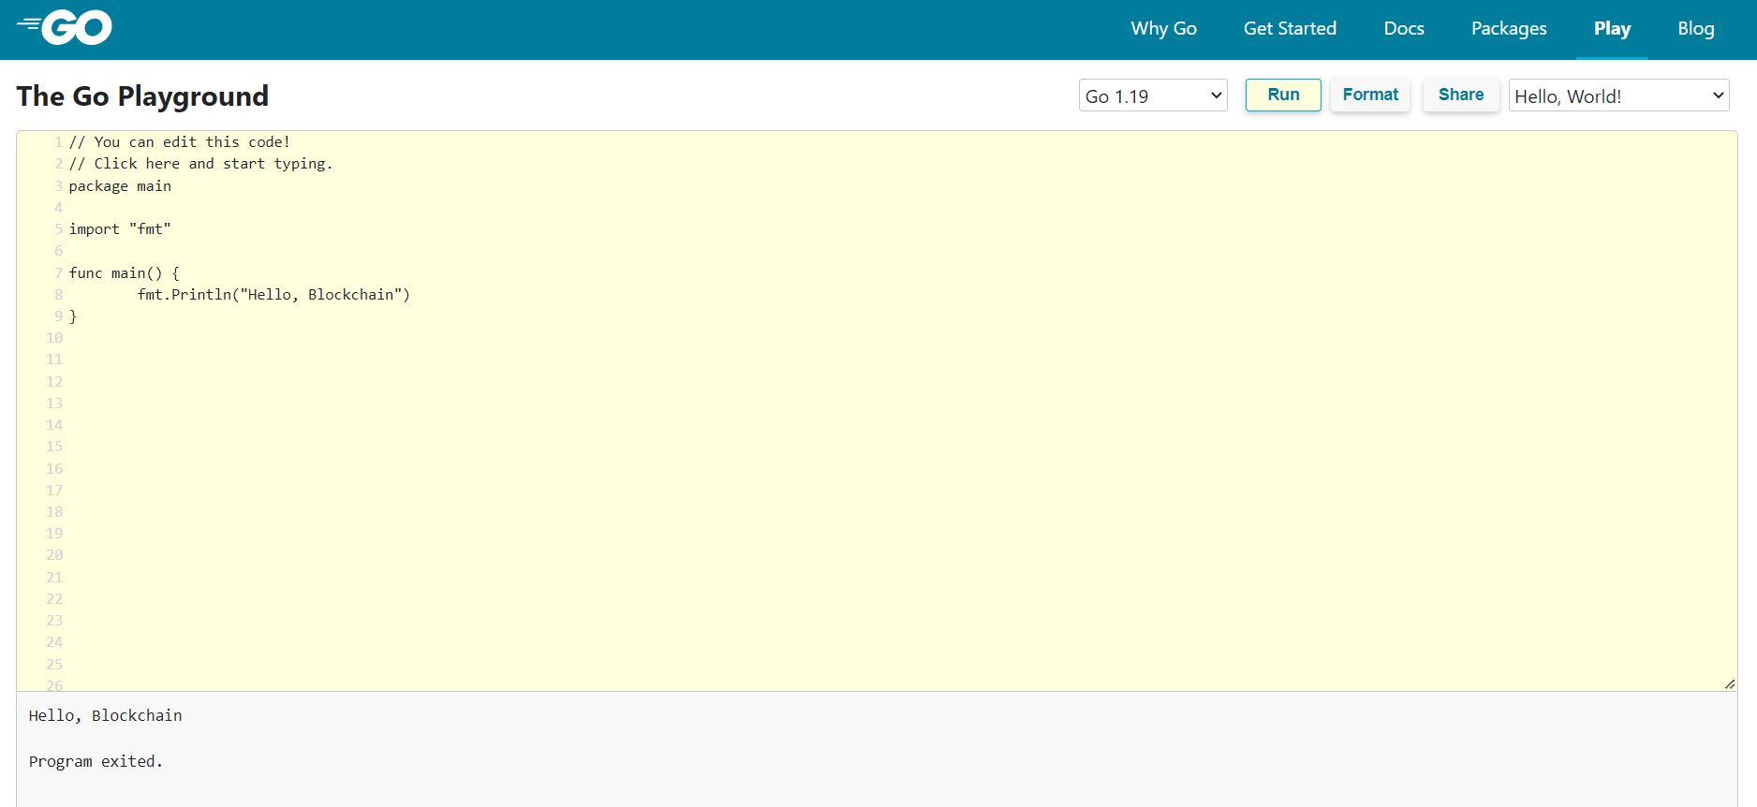
Installing Go

Slide 26
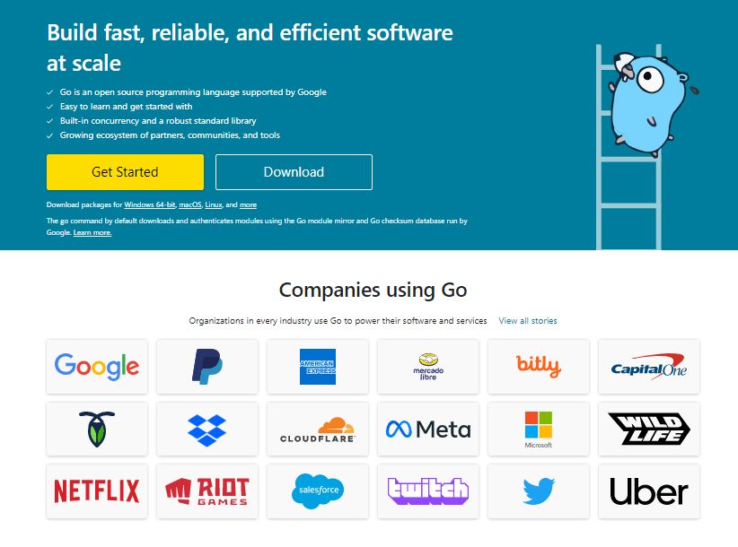
https://go.dev/

Slide 27
Installing Go
You should however install it locally
  Follow instructions at https://go.dev/doc/install, simple steps and binaries provided.
  Download and install using the setup
  The GOPATH environment variable should be setup

Slide 28
Some editors with support for Go
SublimeText with GoSublime
Atom with go-plus

Slide 29
Hello World !!
package main
import "fmt"
func main() {
fmt.Printf("Hello, world.\n")
}
Notes:
The keyword “import” is used for importing a package into other packages.
When you import packages, the Go compiler will look on the locations specified by the environment variable GOROOT and GOPATH. Packages from the standard library are available in the GOROOT location. The packages that are created by yourself, and third-party packages which you have imported, are available in the GOPATH location.

Slide 30
A web server !!
package main
import (
"io"
"net/http"
)
func hello(w http.ResponseWriter, r *http.Request) {
io.WriteString(w, "Hello world!")
}
func main() {
http.HandleFunc("/", hello)
http.ListenAndServe(":8000", nil)
}

Slide 31
Let’s not rush
Before we can move on, it is better to get organized.
Good organization of our code and directories would do wonders ☺

Slide 32
Go and GitHub
The go tool is designed to work with open source code maintained in public repositories.
Although you don't need to publish your code, the model for how the environment is set up works the same whether you do or not.

Slide 33
Workspaces
Go code must be kept inside a workspace.
A workspace is a directory hierarchy with three directories at its root:
  src contains Go source files organized into packages (one package per directory),
  pkg contains package objects, and
  bin contains executable commands.
The go tool builds source packages and installs the resulting binaries to the pkg and bin directories.

Slide 34
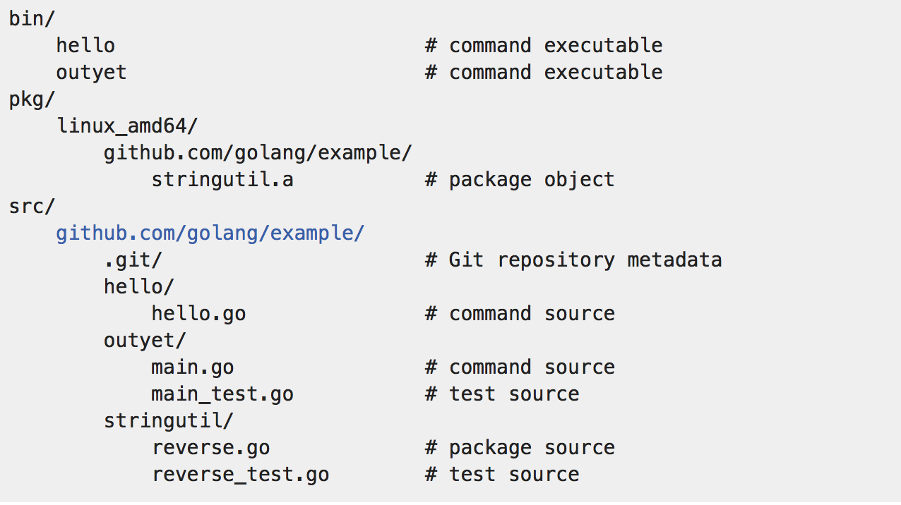
An example

Slide 35

Go and Version Control
If you're using a source control system, now would be a good time to initialize a repository, add the files, and commit your first change.
  Why you should be using one?
  Which one to use?

Slide 36
What is Version Control? (why would I need it...)
Files goes through frequent changes, new files coming in and old ones being deleted.
If you build any kind of application and need to keep track of “versions” of the filesystem, you need version control.
If you need to share coding responsibilities or maintenance of a codebase with another person, you need version control.
If you want to look like a pro at managing your code, keep a consistent history (with ease), and feel comfortable handing it off to someone else, you need version control.

Slide 37
Types of Version Control Systems
Local only - keeps a local database of changes in your local machine filesystem.
Centralized - (Subversion, CVS), require a connection to a central server and “checkout”
Distributed - (Git, Mercurial) allow for local systems to be “mirrors” of the central repo. You don’t need to be connected to the central server to get work or commits done.

Slide 38
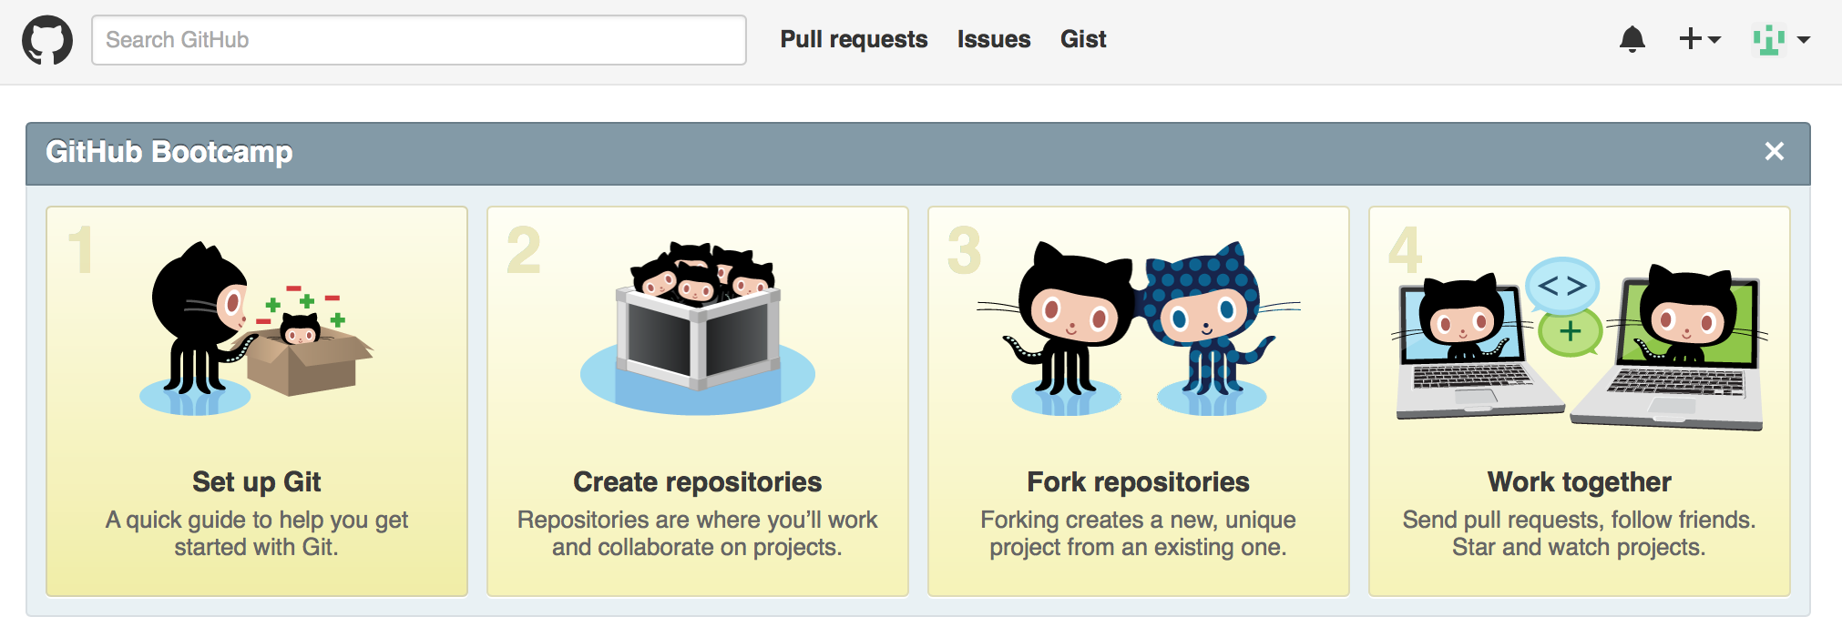
GitHub

Slide 39
What Git is and what it does
small piece of software.
tracks all your files in it’s database. You have to add and remove files into this tracking system and commit them.
a single .git directory at the top of your filesystem “watches” the changes going on and helps you deal with them at commit time.
“git status” will tell you what has been added, removed, modified, etc. etc.
When you make a “commit.” Git records a “snapshot” of changes to your filesystem and records an index number to it. You also write a brief message about the commit.
Commit frequently!

Slide 40
Where it all happens
In each local .git folder.
most activity happens locally. Frequent commits, additions, and changes.
When you’re ready to share your code with others in your team, or want to get it ready for deployment to your servers, you can “push” it to your "remote"

Slide 41
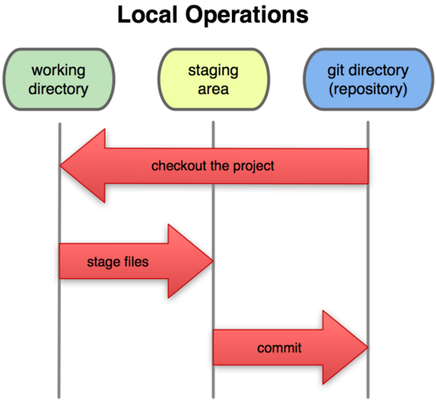
A Local Git project has three areas
Unmodified/modified
Files
Staged
Files
Committed
Files
Note: working directory sometimes called the “working tree”, staging area sometimes called the “index”.

Slide 42
Basic Workflow
Basic Git workflow:
Modify files in your working directory.
Stage files, adding snapshots of them to your staging area.
Do a commit, which takes the files as they are in the staging area and stores that snapshot permanently to your Git directory.
Notes:
  If a particular version of a file is in the git directory, it’s considered committed.
  If it’s modified but has been added to the staging area, it is staged.
  If it was changed since it was checked out but has not been staged, it is modified.

Slide 43
Aside: So what is github?
GitHub.com is a site for online storage of Git repositories.
Many open source projects use it, such as the Linux kernel.
Question: Do I have to use github to use Git?
Answer: No! you can use Git locally for your own purposes

Slide 44

Aside: So what is github?
You can get free space for open source projects or you can pay for private projects.
Student Developer Pack

Slide 45
Get ready to use Git!
Set the name and email for Git to use when you commit:
$ git config --global user.name “Bugs Bunny”
$ git config --global user.email bugs@gmail.com
You can call git config –list to verify these are set.
These will be set globally for all Git projects you work with.
You can also set variables on a project-only basis by not using the
--global flag.

Slide 46
Create a local copy of a repo
Two common scenarios: (only do one of these)
  To clone an already existing repo to your current directory:
$ git clone <url> [local dir name]
This will create a directory named local dir name, containing a working copy of the files from the repo, and a .git directory (used to hold the staging area and your actual repo)
  To create a Git repo in your current directory:
    $ git init
    This will create a .git directory in your current directory.
    Then you can commit files in that directory into the repo:
    $ git add file1.java
    $ git commit –m “initial project version”

Slide 47
Git commands
command | description
git clone url [dir] | copy a git repository so you can add to it
git add files | adds file contents to the staging area
git commit | records a snapshot of the staging area
git status | view the status of your files in the working directory and staging area
git diff | shows diff of what is staged and what is modified but unstaged
git help [command] | get help info about a particular command
git pull | fetch from a remote repo and try to merge into the current branch
git push | push your new branches and data to a remote repository
others: init, reset, branch, checkout, merge, log, tag

Slide 48
Committing files
The first time we ask a file to be tracked, and every time before we commit a file we must add it to the staging area:
$ git add hello.java
This takes a snapshot of these files at this point in time and adds it to the staging area.
To move staged changes into the repo we commit:
$ git commit –m “Fixing bug #22”
Note: These commands are just acting on your local version of repo.

Slide 49
Status and Diff
To view the status of your files in the working directory and staging area:
$ git status or
$ git status –s
To see what is modified but unstaged:
$ git diff

Slide 50
Viewing logs
To see a log of all changes in your local repo:
$ git log or
$ git log --oneline (to show a shorter version)
  1677b2d Edited first line of readme
  258efa7 Added line to readme
  0e52da7 Initial commit
git log -5 (to show only the 5 most recent updates, etc.)

Slide 51
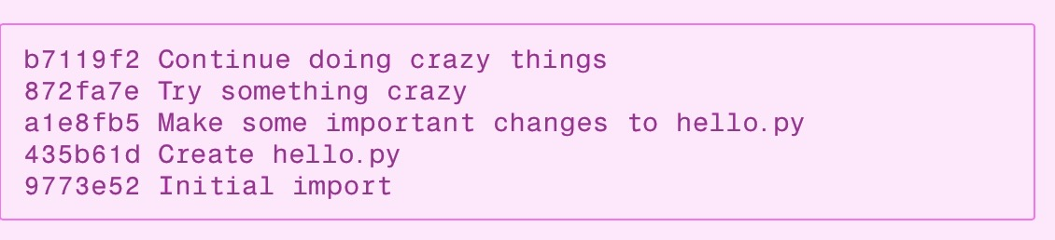
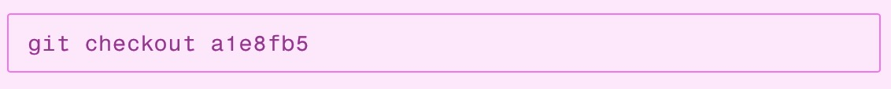
Undoing Changes - git checkout
Undo changes to a file since last commit
  git checkout -- filename
Look at previous version of project
Notes:
https://www.atlassian.com/git/tutorials/undoing-changes

Slide 52
Undoing Changes - git checkout
If you liked some particular file in previous version – you can restore it

Slide 53
Remote Repositories – Push and pull
To push our local repo to the GitHub server we'll need to add a remote repository.
  git remote add origin <remote-repo-url>
  git push -u origin master
Pulling is just as simple
  git pull origin master

Slide 54
A Tour of Go
We would be following the online tour
  https://tour.golang.org or go tool tour

Slide 55
Hello World !!
  package main
  import "fmt"
  func main() {
  fmt.Printf("Hello, world.\n")
  }

Slide 56
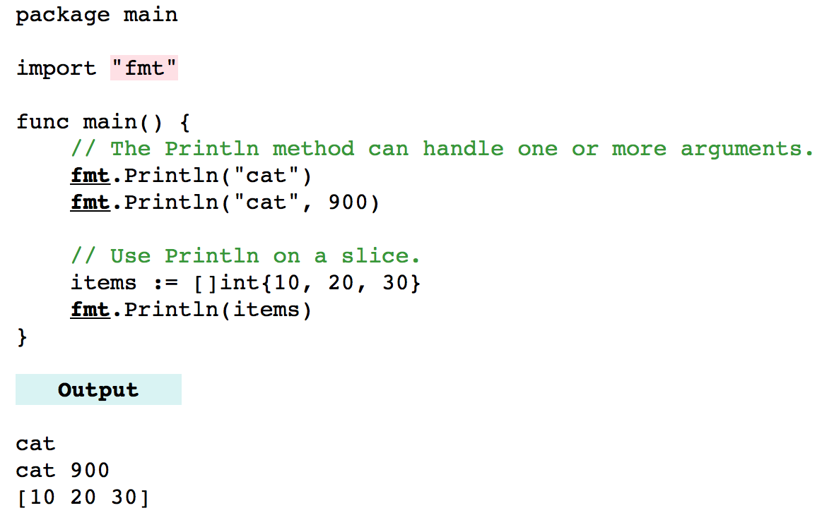
Printing on Console – The fmt package
Notes:
http://www.dotnetperls.com/fmt-go
Slice is a variable-length sequence which stores elements of a similar type, you are not allowed to store different type of elements in the same slice. It is just like an array having an index value and length, but the size of the slice is resized they are not in fixed-size just like an array.

Slide 57
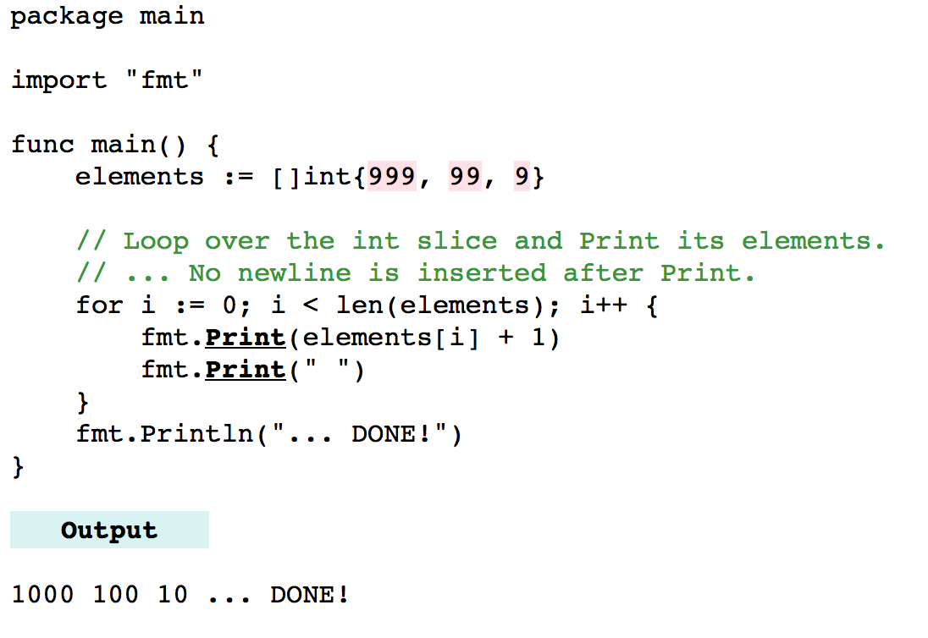
Printing on Console – The fmt package
Notes:
http://www.dotnetperls.com/fmt-go

Slide 58
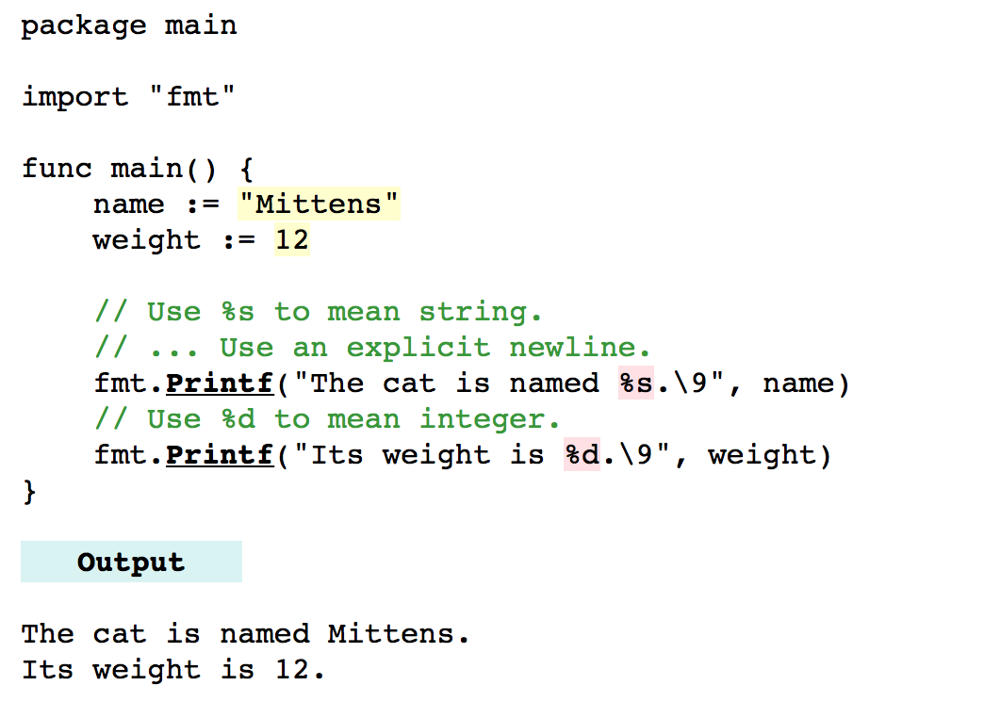
Printing on Console – The fmt package
Notes:
http://www.dotnetperls.com/fmt-go

Slide 59
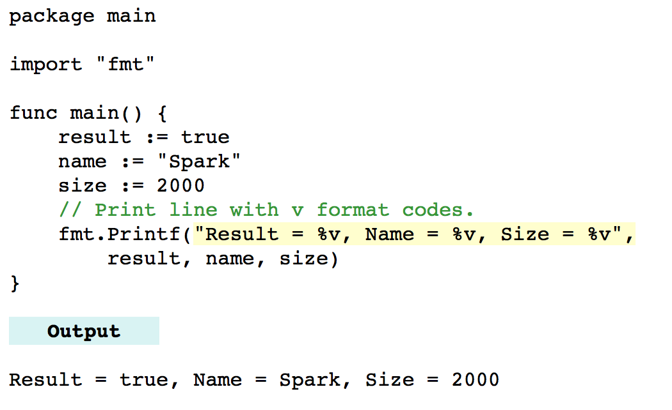
Printing on Console – The fmt package
Notes:
http://www.dotnetperls.com/fmt-go

Slide 60
A tour of Go
Packages/Imports/Exported names/Functions/Variables/Initializers

Slide 61
Go Packages and Exported Names
Let's write a library and use it from the hello program, greetings.
$ mkdir $GOPATH/src/github.com/user/greetings
Create a file named mygreetings.go with following code
//Package greetings shows the greetings
package greetings
//GreetingsString is a global variable
var GreetingsString = "Hello World"
//PrintGreetings is a global function
func PrintGreetings(name string) string {
return GreetingsString + "-" + name
}
Notes:
https://tour.golang.org/basics/1

Slide 62
Go Packages and Exported Names
Next, modify the hello.go to have the following code:
package main
import (
"fmt"
"github.com/user/greetings"
)
func main() {
fmt.Printf(greetings.PrintGreetings("ad "))
}
Notes:
https://tour.golang.org/basics/1

Slide 63
A few words about godoc
A simple, elegant and highly effective approach to document your work (my own words!)
We added some comments with our package
If we godoc -http=:6060 and navigate to localhost:6060/pkg/github.com/ehteshamz/greetings, we can see these comments!!
Notes:
https://tour.golang.org/basics/1, some rules on how to write comments exists.

Slide 64
Remote repositories
It is good time to push our package to the GitHub,
Anyone can then use our wonderful greetings package
You know how to do this?
  git init/add/commit/push … piece of cake ☺

Slide 65
Remote repositories
Lets delete our local repo and get it from GitHub
This shows how to use remote repos in the Go
go get github.com/user/greetings
…and we have our package back ☺

Slide 66
Remote repositories
Lets do some image processing …
go get -u github.com/disintegration/imaging
…and we have an image processing library
package main
import (
"github.com/disintegration/imaging"
)
func main() {
img, _ := imaging.Open("01.jpg")
thumb := imaging.Thumbnail(img, 100, 100, imaging.CatmullRom)
imaging.Save(thumb, "dst.jpg")
}

Slide 67

Arrays
Go's arrays are values.
An array variable denotes the entire array; it is not a pointer to the first array element (as in C/C++).
This means that when you assign or pass around an array value you will make a copy of its contents.

Slide 68
Passing Arrays
Go's documentation makes it clear that arrays are passed by copy.
How to achieve pass by reference?
  Option A - use pointers, complex and less elegant
  Option B - Use slices

Slide 69
Slices
Slices build on arrays to provide great power and convenience.
A slice literal is declared just like an array literal, except you leave out the element count:
      letters := []string{"a", "b", "c", "d"}
      var s []byte
      s = make([]byte, 5, 5)
      // s = []byte{0, 0, 0, 0, 0}

Slide 70
Slicing Slices
b := []byte{'g', 'o', 'l', 'a', 'n', 'g'}
// b[1:4] == []byte{'o', 'l', 'a'}, sharing the same storage as b
// b[:2] == []byte{'g', 'o'}
// b[2:] == []byte{'l', 'a', 'n', 'g'}
// b[:] == b

Slide 71
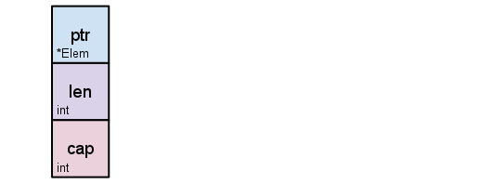
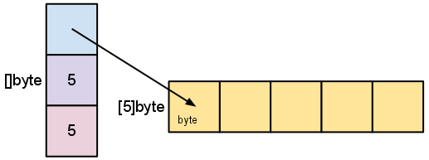
Slice Internals
A slice is a descriptor of an array segment. It consists of a pointer to the array, the length of the segment, and its capacity (the maximum length of the segment).
Our variable s, created earlier by make([]byte, 5), is structured like this:

Slide 72
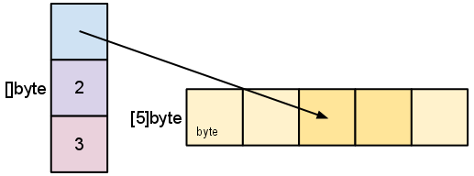
Slice Internals - Slicing
s = s[2:4]

Slide 73
Slice Internals - Slicing
Slicing does not copy the slice's data.
It creates a new slice value that points to the original array.
Therefore, modifying the elements (not the slice itself) of a re-slice modifies the elements of the original slice
    d := []byte{'r', 'o', 'a', 'd'}
    e := d[2:]
    // e == []byte{'a', 'd'}
    e[1] = 'm'
    // e == []byte{'a', 'm'}
    // d == []byte{'r', 'o', 'a', 'm'}

Slide 74
Erratum – Go Modules
The support of go modules was added in v1.11 but wasn’t enforced for $GOPATH packages till recent versions.
Packages are handled differently with the support and enforcement of go modules.

Slide 75
GO111MODULE
If you have made the change as announced on the classroom, you need to undo. It should be on or empty
You can check the go environment variables by using the command shown below:
go env

Slide 76
Go modules - Introduction
They serve many purposes
  Dependency management, using multiple versions of the downloaded packages
  Packages from go get are not cluttered in $GOPATH/src and go code can be written in directories other than $GOPATH
  …

Slide 77
back to the greetings package
//Package greetings shows the greetings
package greetings
//GreetingsString is a global variable
var GreetingsString = "Hello World"
//PrintGreetings is a global function
func PrintGreetings(name string) string {
return GreetingsString + "-" + name
}
Notes:
https://tour.golang.org/basics/1

Slide 78
back to the greetings package
With the go modules its path is not guided by the directory structure but rather a file named go.mod

Slide 79
Getting started
Go modules are initialized by the go init command followed up by the path of the module
This creates a file named go.mod in the same directory. The contents of the file are shown below, it names the module and go version needed for this module.

Slide 80
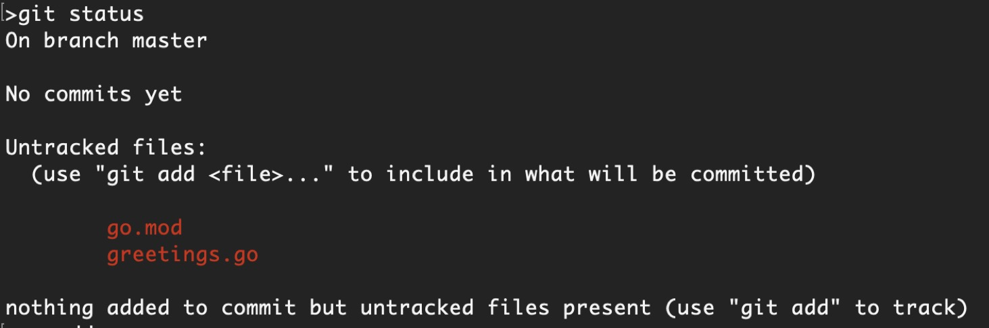
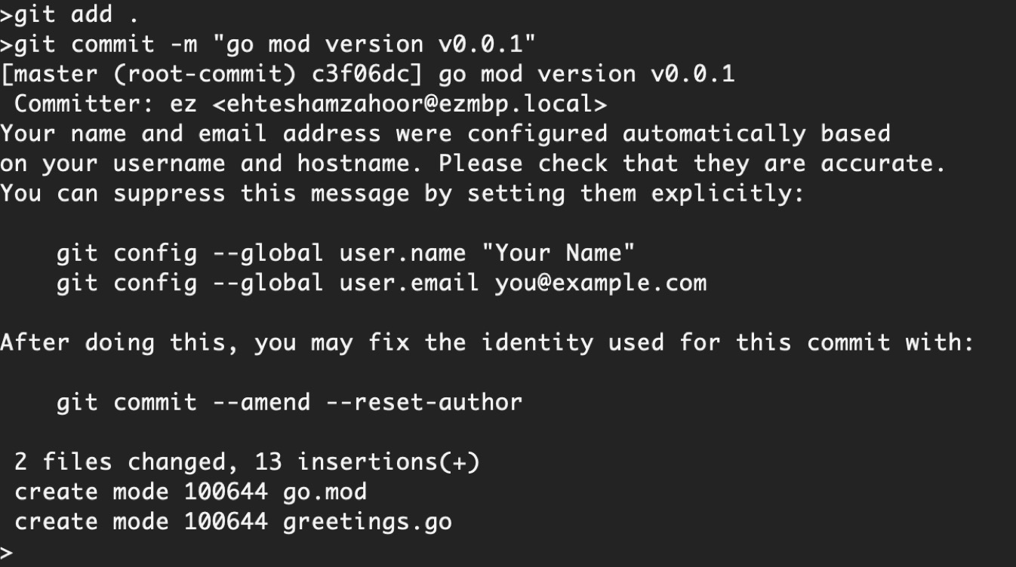
Version control using git
We know how to do this, right?

Slide 81
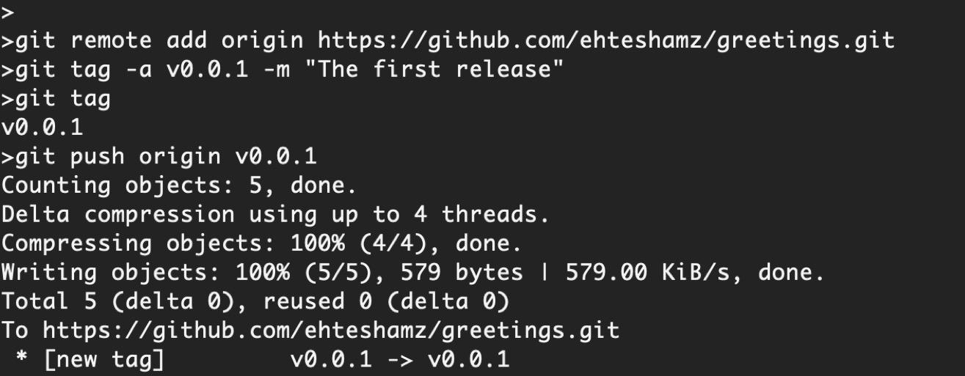
Git tags
Using git we can tag our releases (provide versions) and push on the github.
We call our first release v0.0.1

Slide 82
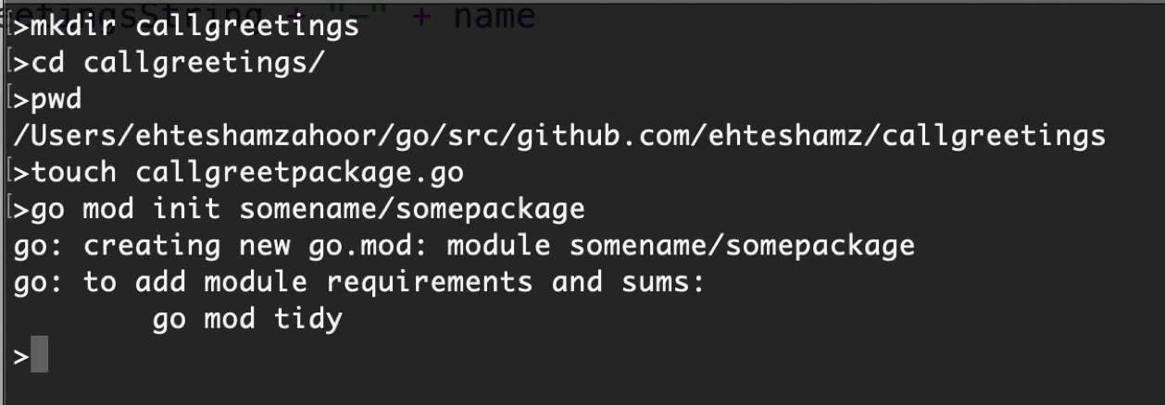
getting and using the greetings package
Lets create another directory for the main file that uses this package and add the appropriate content.
With the go modules we need to again initialize and the choice of name is less important, as it is main package.

Slide 83
getting and using the greetings package
We add the following code for invoking the package
package main
import (
"fmt"
"github.com/ehteshamz/greetings"
)
func main() {
fmt.Printf(greetings.PrintGreetings("ez "))
}

Slide 84
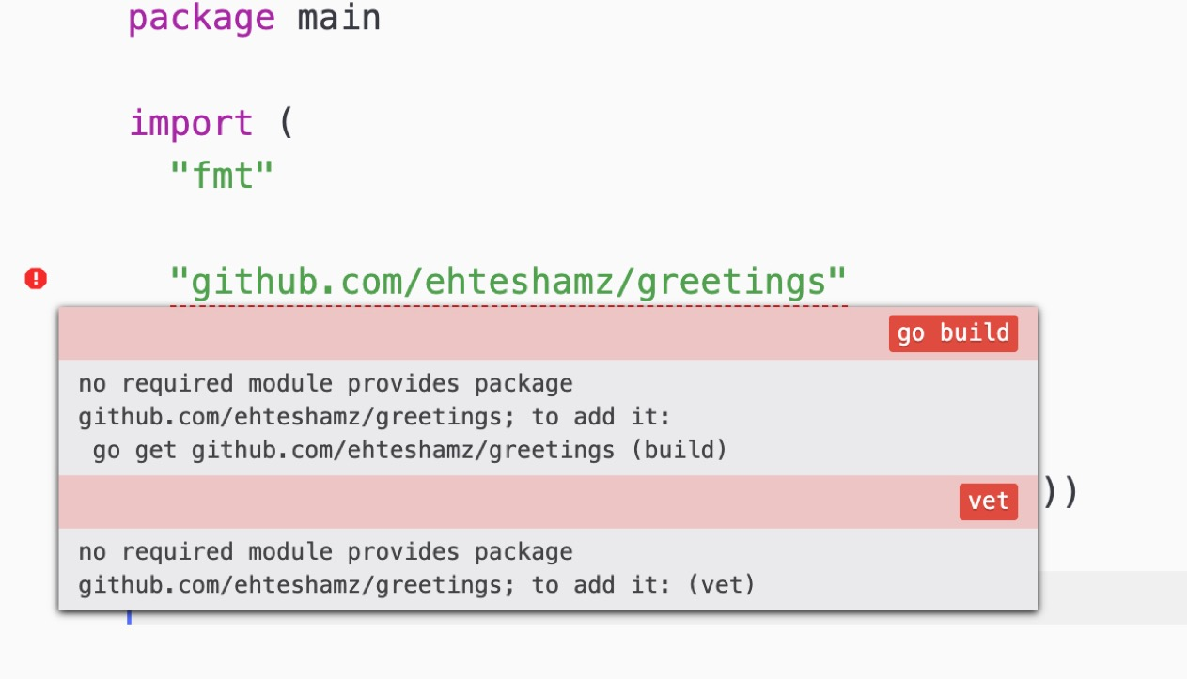
go tools at atom are not happy

Slide 85
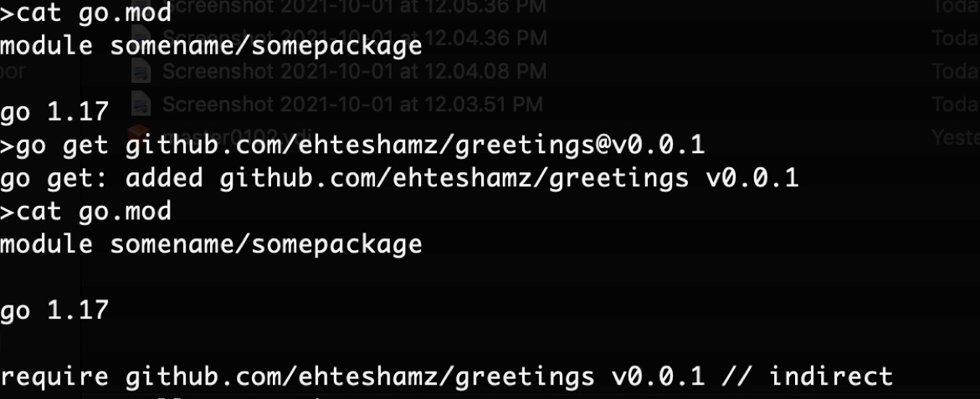
Adding dependency
We have not added dependency for our main package that it needs the greeting module.
This can be done by editing the go.mod file or just running go get in the same folder
You can notice that we are adding version info with the package and how the contents of go.mod change

Slide 86
Adding dependency
*If you receive an error while running the go get command with text including “incorrect version” and ”could not read Username” you need to set an environment variable
What does it say? It says our repository is private and go should not use the proxy service (goproxy.io) check its validity by checksum.
go env -w GOPRIVATE=github.com/yourusername

Slide 87
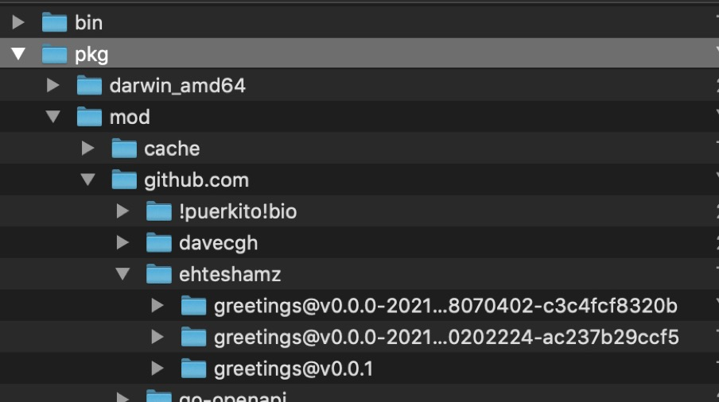
Where the packages are downloaded
No longer in the $GOPATH/src but rather in the $GOPATH/pkg
Notice we have now multiple versions (downloaded earlier) of greetings package including the one needed

Slide 88
Running the code
For Atom, the script package can now run go code directly. Use it instead of build
>go run callgreetpackage.go
Hello World-ez >

Slide 89
So far so good but …
What if we change out local greetings module to say Bonjour Monde instead of Hello World?
//Package greetings shows the greetings
package greetings
//GreetingsString is a global variable
var GreetingsString = "Bonjour le Monde"
//PrintGreetings is a global function
func PrintGreetings(name string) string {
return GreetingsString + "-" + name
}

Slide 90
Working locally – the (very) wrong way
Running the callgreetpackage.go again doesnt reflect the change ☹
We can again publish this on the github say v0.0.2 and then go get, update go.mod and use the newer version.

Slide 91
Working locally – the right way
We can add a replace directive at the go.mod (for the callgreetings module).
What does it say?
module somename/somepackage
go 1.17
replace github.com/ehteshamz/greetings => ../greetings
require github.com/ehteshamz/greetings v0.0.2 // indirect

Slide 92
Greetings in Pashto ☺
We change the local version to this but do NOT push this to github as say v0.0.3
//Package greetings shows the greetings
package greetings
//GreetingsString is a global variable
var GreetingsString = " سلام نړی "
//PrintGreetings is a global function
func PrintGreetings(name string) string {
return GreetingsString + "-" + name
}

Slide 93
Running the main package …
go run callgreetpackage.go
سلام نړی-ez

